Slide 1



Participation groups training package
2022
Notes:
Slide 1: What is the training for?
This is training is available to all settings to support developing participation groups in schools and youth services.
This training package is not exhaustive and can be adapted based on individual groups, changing needs of the young people and differences in the young people attending your setting. This is a working document for your setting to adapt, update and change.
The training package looks at: -
The reasons behind why participation is so important (setting the scene)
The advantages of participation groups (both for young people and your setting.)
Models of participation (4 outlined in the package that have been used in successful groups.)
Success tools used in other studies/ participation groups.
Importance of peer -on-peer support for children and young people.
Highlights existing youth groups locally and nationally.
Resources pack/ research pack available.

Slide 2

Setting the scene- The why?
Children’s voice
Rapid review 2021
Belonging Strategy and One City Plan
Ofsted
UNCRC
Notes:
Slide 2: Setting the scene (the why?):
Children’s voice- During the pandemic, children and young people reported they would like to see more education around diversity, life skills, and relationships within the RHSE (relationships, sex and health education) and PHSE curriculum (personal, social and health education) offered in schools.
Rapid Review- In 2021, KBSP undertook a child safeguarding rapid review following the tragic death of a young person and her unborn baby. The rapid review found that there was an increase in late bookings and unexpected pregnancies during the pandemic. The review made recommendations to improve the way children and young people in Bristol receive education and information about local sexual health and pregnancy services.
Belonging Strategy- Bristol City Council’s Belonging Strategy was published in October 2021. It sets out how the city will begin to recover from the pandemic. The new strategy supports the One City Plan. One of the aims of the strategy is for everyone in Bristol to have the best start in life, to be able to gain the support and skills they need to thrive and prosper in adulthood. The strategy also sets out a collective vision to ensure the voices of Bristol’s children and young people are heard in the city. Ensure that all children and families feel that they ‘belong’ and have their voices heard in decisions that affect them, with a particular focus on those who are most marginalised. This involves identifying those who do not feel included and finding different ways to help them participate, proactively tackling barriers, following best practice and seeking continuous feedback from families. Children grow up warm, fed and listened to – their voice is important. Inclusion in education is about ensuring that every learner feels valued and respected, and can enjoy a clear sense of belonging”
Ofsted- In June 2021, Ofsted published their review of findings on peer-on-peer sexual abuse and sexual harassment within schools and colleges following a request from government to undertake a rapid review. The Executive summary of their findings state:
Central to this should be a carefully planned and implemented RHSE curriculum, sanctions and interventions to tackle poor behaviour and provide support for children and young people who need it, training and clear expectations for staff and governors, and listening to pupil voice. Alongside this, Ofsted’s School Inspection Handbook (1st September 2021) has a list of expectations for schools to achieve Outstanding which participation groups would effectively contribute to.
UNCRC- (United Nations Convention on the Rights of the child) – Articles 12, 13 and 31 state that children and young people have the right to express their own views freely; the right to freedom of expression and the right to participate freely in cultural life and the arts. Article 17 highlights the need for children to ‘assess information and material from a diversity of …. sources, especially those aimed at the promotion of his or her social, spiritual and moral well-being and physical and mental health.’ Article 23 is in relation to children and young people with disabilities: States Parties recognize that a mentally or physically disabled child should enjoy a full and decent life, in conditions which ensure dignity, promote self-reliance and facilitate the child’s active participation in the community.

Slide 3

Advantages for young people
Voice
Empowerment
Diversity and Inclusivity
Development
Trauma informed/welfare based
Fun
Notes:
Slide 3: Advantages of participation groups for children and young people:
Voice- By enabling children in the community to share their lived experience and what does/doesn’t work for them we hear their voice. We also need to follow through on that by enabling them to be part of changes via active participation in the groups which in turn drive changes. “You have been heard and this is what next.” This shifts to using the model of young people being our subject matter experts in the community.
Empowerment – by enabling young people to be involved in decision making this enables them to feel empowered in direct involvement in change rather than things being done to them but instead done with them driving the change.
Diversity and inclusivity – Participation enables a 3 point relationship between young people, the community and adults involved in making changes. This also enables marginalised groups to receive increase status/ stature in the community by increased control/ power in decision making. The role of participation also enables difference to be valued and commonalities to be identified.
Development- young people develop skills that can be used for their future education, work and social integration (for example problem solving, communication and negotiation skills.)
Trauma-informed and welfare based – By involving children and young people in participation we achieve trauma informed approach by enabling safety, choice and clarity, collaboration, building trust, empowerment and include everyone. Children and young people who feel valued in their contribution in turn supports their own welfare and supports their sense of belonging and improves their self-confidence/self-esteem.
Having fun- enabling children to be part of groups with their peers with a clear purpose can be fun.

Slide 4

Advantages for SETTINGS
Community informed.
Different perspective
Relationships and mutual respect.
Increased capacity/ sustainability
Reputation and credibility
Strategic priorities and upholds children’s rights.
Notes:
Slide 4: Advantages for the setting:
Community informed- Policies and services are designed, delivered and evaluated on the basis of emerging needs of children leading to them being more effective and current.
Different perspective- all children/ young people are able to offer a different perspective to those of adults.
Relationships- Participation groups enables enhanced relationships with children and young people for the organisation and builds mutual respect.
Increased capacity and sustainability- Young people in themselves are a human resource so by involving them and empowering them directly in decision making and change this enables capacity and sustainability across your setting.
Increases reputation and credibility- your setting becomes more credible by virtue of listening and involving young people in decision making.
Supports meeting local and national strategic priorities and upholds children’s right (go back to slide in setting the scene.)

Slide 5
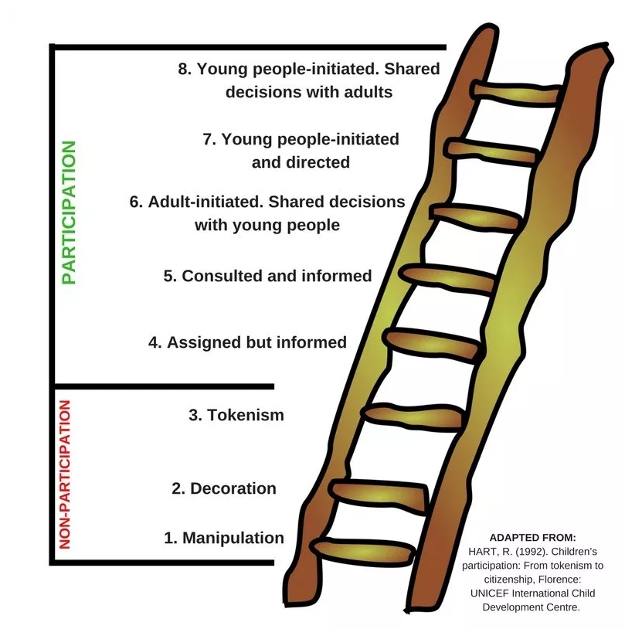
Roger Hart 1992
Notes:
Slide 5: Roger Hart participation model 1992:
Childrens_participation.indd (unicef-irc.org)
The first 3 rungs on the HART ladder are around non-participation. This is what we are seeking to avoid as they are all adult led decision making
Manipulation (adults manipulating children to carry their message when the child has little/ no understanding of the cause.)
Decoration (encouragement of children to wear or display items linked to the cause with little/ no understanding of the cause.) t
Tokenism- the appearance of young person having a voice but have in fact little/ no choice about the subject/ decision making.)
Moving up the 5 further rungs of the ladder enables active participation (beginning of youth involvement) through to youth-led participation at rung 8 (our aim would always be to get to rung 8.)
The model is considered working progress within youth participation groups nationally where you begin at rung 4 and move towards rung 8.
Rung 4- Assigned but informed: Adult-led activities in which young people have a role and part.
Rung 5- Consulted and informed: Adult-led activities in which young people are consulted and informed about how their input will be used in adult’s decisions.
Rung 6- Adult initiated with shared decisions: Adult led activities in which decision making is shared with young people.
Rung 7- Youth initiated and directed: Activities led by young people will little adult input.
Rung 8- Youth initiated shared decisions: Activities led by young people with decision making by young people and then shared with adults and other youths as equal partners.

Slide 6
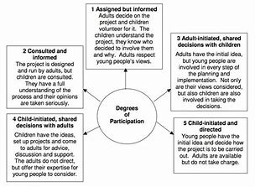
Phil Treseder 1997
Notes:
Slide 6: Phil Tresder participation model 1997:
Participatory practice.pdf (sagepub.com)
Phil Tresder’s wheel of participation:
The wheel moves through 5 stages of adult led projects/ discussions (1-3) with children consulted through to stage 5 where we see child-initiated projects with supports from adults rather than adults taking charge.
This model also relies on positive principles behind each element of the wheel
1. Although adult led children still gain access to those in a position of power.
2 Although adult led children gain access to relevant and important information.
3. Choice- children are given real choices/ different options by adults.
4. Support- support from trusted adults.
5. Means of appeal/ complaint to adults.

Slide 7
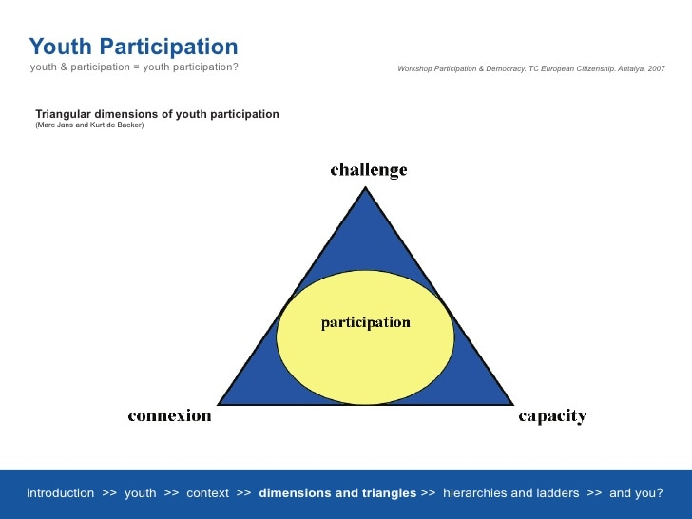
Jans and De Backer 2002
Notes:
Slide 7: Jans and De Backer participation model (triangle approach):
Participation-models-Andreas-Karsten-1c07.pdf (plataformadeinfancia.org) (page 13)
The Jans and De Backer model looks at a triangular approach of participation that requires the dynamic balance between challenge, connection and capacity to achieve participation of young people.
Challenge: The challenge relates to a topic/ theme (whether personal or social) that the young person can identify with/ relate to.
Capacity: This relates to young people feeling that they can have a grasp on the challenge and can make a difference through their efforts. Their capacity to make a difference will to a great extent incite their participation.
Connection: Young people have to feel connected with and supported by humans, communities, ideas, movements, range of thoughts, organisations in order to work together on the challenge identified.

Slide 8
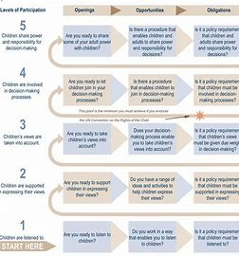
Harry shier 2001
Notes:
Slide 8: Harry Shier Model 2001:
pathways-to-participation.pdf
Harry Shier’s pathways to participation diagram identifies five levels of participation.
The Shier diagram is a practical planning and evaluation tool that can be applied in almost all situations where adults work with children.
Its purpose is to help adults to identify and enhance the level of children and young people’s participation in terms of five levels and considers openings (how do we enable children/ young peoples voice to be heard), opportunities (how do we seize opportunities to involve young people) and obligations (strategic priorities and policies and rights of children.)
Stage 1- Initial consultation faze with children.
Stage 2- Enabling the child’s voice
Stage 3- Hearing the child’s voice for change.
Stage 4- Acting on children’s voice for change and involving them in decision making.
Stage 5- Shared power and responsibility (equal partnership.)
Before moving onto success tools slide, ensure that everyone is aware youth participation is an approach/model that needs to be continual and reviewed, it is not a ‘thing’ to be done once and ticked off (Holdsworth 2001.)

Slide 9

Workshops/ focus groups
Park it boards
Snap/ slido poll surveys
Defining reporting structures.
Peer on peer support for facilitators
Emotional touch points
Compensation
After action reviews
Icebreakers and group agreements.
Location
Role plays/ case studies
Affirmations and praise
Anonymous suggestion- linked to internal portals available.
Culture.
Ketso
Notes:
Slide 9: Success tools:
These are a list of success tools used in other participation groups across Bristol and nationally.
Workshops/ focus groups/ sub groups- These can take place in person, online or hybrid (mix of the two) to reach all young people.
Park it boards- within the school/ community setting for feedback from young people from set-up, throughout around the group and for quality assurance on what could be different. This has also taken the form of comment cards in some groups nationally where a physical park it board wouldn’t be accessible for all. These could also be in the form of anonymous feedback jars also as another physical form to achieve this.
Snap Surveys/ slido poll- enable anonymous feedback and accessible as online. Both platforms are able to use QR codes so quick and easy to access for young people who use technology.
Defining structures- the change agreed within the groups needs to have an appropriate reporting structure to achieve that change. This will be different for all organisations but needs to be outlined from the start to manage the expectations of the group and ensure they know who governs and/or agrees the changes they suggest. Groups that flourished in other studies show enabling young people to feedback themselves to people in power/ strategic roles was equally important.
Peer on peer support across settings- facilitating participation groups can be positive but equally bring challenges (both practical and emotional.) Successful groups identified the need and developed a peer-on peer-support structure with other local providers similar to themselves to discuss challenges/ barriers and positives/ solutions to this across the longevity of the group (from implementation> throughout.)
Emotional touch points- Flash cards displaying different types of emotion used within the groups to support expression of feeling and impact of the group and change with visual aids.
Compensation for time- consideration of how you offer renumeration/compensation for young people involved in the participation groups is vital. This enables them to feel valued for their time and efforts to effect change. This could be in the form of financial, time renumeration or merit structures locally with settings.
After action reviews- This involves the group analysing action/ change that has been taken to enable youth quality assurance throughout.
Icebreakers and group agreements- Your goal is to generate a safe space. Icebreakers assists in building integration with a group as it identifies common ground from the start despite being different but also sparks discussion about differences in opinion/ view too (for example: if you could eat one food for the rest of your life what would that be?) Ensuring a group agreement that everyone agrees to at the beginning is key to manage expectations (care/ welfare “be kind to self and others, being inclusive and embracing differences, confidentiality “ensure that any lived experience is shared in a safe space”, timekeeping “manage expectations around timeframe of engagement)
Location- if in person ensuring a practical, comfortable environment with correct equipment, lack of distractions and accessible to all is important. Consider those who would struggle to meet in person and offer online/ hybrid models. The most successful groups identified used hybrid models ensuring which ensured the groups were accessible particularly to those with SEND needs and protected characteristics.
Role plays/ case studies- This enables more immersive thinking and comment. Young people can “walk a mile in someone else’s shoes” and comment on the positive and negative.
Affirmations and praise- successful participation groups build in affirmation and praise in each session where every young person feels valued for their contribution (bulletin thank you boards, thank you cards exchanged, gratitude journals (“the group is thankful for……….?”), praise videos, contributor of the month awards.
Culture- other successful groups have staff in their setting who are passionate about young people’s participation. A participation culture needs to be developed to ensure that participation isn’t tokenistic and rests at the heart of decision making within the setting.
Ketso visual tool- the subject/ theme is placed in the middle as the trunk, with up to 5 elements as the branches under the theme. The young people then place ideas as the leaves.

Slide 10
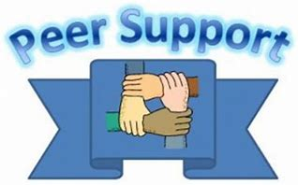
Support
Inclusivity
Friendship
Notes:
Slide 10: Peer on peer support:
Peer on peer support is a participation model in itself. This is different from adult led models in participation where you move away from the helper and being helped to equal power dynamic and natural friendships built within peer on peer support. It is recognised across the UK and in other countries that peer on peer support enables children to talk about difficult subjects as peers rather than with adults.
The three main things achieved as a result of peer-on-peer are support, inclusivity and friendship.
Things to consider when developing/embedding peer-on-peer support:-
Group agreement- Clear safety ground rules across the peer group.
Language- does your school/ setting use helper/ mentee/ tutor or more inclusive language such as peer, friend, classmates. This needs to be reciprocated with adults moving away from child A helping child B to we are working together.
Quality assurance- while the peer-on-peer support needs to be naturally formed there is a need for adults to quality assure the process. The fidelity checklist in the resource pack is a checklist from a study in America around quality assuring peer support groups in American schools.
How to building friendships and a sense of belonging- this links back to the Belonging strategy
Ensuring inclusivity across the peer group (how do you reach children with protected characteristics and from marginalised communities and ensure equity while recognising difference.)
Supporting setting of common goals for the group by themselves as peers.
Advertising/ promotion- how do you reach everyone? Assemblies/ existing support groups/ online access or in person advertising.
Space to hold the peer group- do you have an appropriate physical space that is approachable and accessible to all.

Slide 11
Existing bristol Youth groups
Freedom (LGBTQ+)
Unity Youth forum (BAME young people)
Children in care council
Gypsy Romany Traveller Youth group (Learning Partnership West and Bristol City Council)
Listening partnership (disability and SEND)
Bristol City Youth Council, Youth Mayors and UK Youth Parliament
Shadow board.
Youth Opinions in Filwood – Run by Youth Moves
Young Carers Voice – Carers Support Centre
Area forums (South, North and East Central.)
Greenhouse Young Person’s Group.
Notes:
Slide 11: Existing youth groups:
The existing youth groups locally are linked with the equality duty.
Freedom- (LGBTQ+ community)
Unity- (Black minority ethic young people)
Children in care council
Young carers service.
GRT group in LPW and training via council (Ian Bowen) and LPW.
Listening partnership (disability and SEND.)
Youth council
Shadow Board
Youth Opinions in Filwood- run by Youth Moves
Young Carers Voice- Carers Support Centre
Area Forums (South, North and East Central.)
Greenhouse Young Person’s group.
National/ international groups-
Shout out UK- social enterprise that aims to get more young people involved in democratic life through our political and media literacy programmes and democratic engagement campaigns- Shout Out UK - The home of political literacy and youth voice
Lumos- Institute in USA that advocate for youth voice- Tools and Resources - Lumos (wearelumos.org)
Council for disabled children- Charity who support participation of disabled children and children with SEND needs- Making Participation Work (councilfordisabledchildren.org.uk)
National Youth agency- National Charity with skilled youth workers building relationships that support young people to explore their personal, social, and educational development- NYA

Slide 12
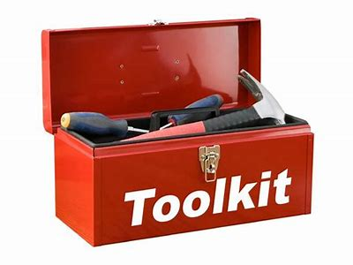
Resource pack
Toolkits
Peer to peer fidelity checklists: Peer to Peer: Fidelity and Data Tools - START Project - Grand Valley State University (gvsu.edu)
Seeds for change community engagement- tools.pdf (seedsforchange.org.uk)
Sefton toolkit- 11.1 Youth Participation Strategy Toolkit.pdf (sefton.gov.uk)
NHS toolkit used in patient participation- Microsoft Word - PPG Toolkit.1[3][1].doc (kpin.org.uk)
Notes:
Slide 12: Toolkit resource pack:
This resource pack details toolkits used by other successful participation groups to commence and quality assure the groups.
Peer to Peer: Fidelity and Data Tools - START Project - Grand Valley State University (gvsu.edu)
tools.pdf (seedsforchange.org.uk)
11.1 Youth Participation Strategy Toolkit.pdf (sefton.gov.uk)
Microsoft Word - PPG Toolkit.1[3][1].doc (kpin.org.uk)

Slide 13

Resource pack
Research/ guidance pack on participation
Tisdall 2014- Tisdall, E. K. M., Gadda, A. & Butler, U. (2014) Introduction: Children and young people’s participation in collective decision-making. In: Tisdall, E. K. M., Gadda, A., Butler, U. (Eds) Children and Young People’s Participation and Its Transformative Potential, Basingstoke: Palgrave Macmillan, pp.1-21.
Johnson 2015- Johnson, V. (2015) ‘Valuing children’s knowledge: the politics of listening’. In: Eyben, R., Guijt, I., Roche, C., Shutt, C. (Eds) The Politics of Evidence in International Development: Playing the Game to Change the Rules? Warwickshire: Practical Action Publishing, pp.155-171
Mannion 2007- Mannion, G. (2007) ‘Going Spatial, Going Relational: Why “listening to children” and children’s participation needs reframing’. Discourse: Studies in the Cultural Politics of Education. 28 (3): 405-420.
Social care of excellence- Participation (finding out what difference it makes)- Participation - finding out what difference it makes - Guide home (scie.org.uk)
Learner Participation in Educational Settings (3-18)
UNCRC- Microsoft Word - YOUTH Participation_2013-11-12.docx (un.org)
successful-strategies-facilitating-the-inclusion-of-marginalized-groups.pdf (idea.int)
Youth Group in Mental health settings (Australia)- The importance and benefits of youth participation in mental health settings from the perspective of the headspace Gosford Youth Alliance in Australia - ScienceDirect
Notes:
Slide 13: Research resource pack:
This resource pack details research documents around successful participation.
Tisdall 2014- Tisdall, E. K. M., Gadda, A. & Butler, U. (2014) Introduction: Children and young people’s participation in collective decision-making. In: Tisdall, E. K. M., Gadda, A., Butler, U. (Eds) Children and Young People’s Participation and Its Transformative Potential, Basingstoke: Palgrave Macmillan, pp.1-21.
Johnson 2015- Johnson, V. (2015) ‘Valuing children’s knowledge: the politics of listening’. In: Eyben, R., Guijt, I., Roche, C., Shutt, C. (Eds) The Politics of Evidence in International Development: Playing the Game to Change the Rules? Warwickshire: Practical Action Publishing, pp.155-171
Mannion 2007- Mannion, G. (2007) ‘Going Spatial, Going Relational: Why “listening to children” and children’s participation needs reframing’. Discourse: Studies in the Cultural Politics of Education. 28 (3): 405-420.
Social care of excellence- Participation (finding out what difference it makes)- Participation - finding out what difference it makes - Guide home (scie.org.uk)
Learner Participation in Educational Settings (3-18)
UNCRC- Microsoft Word - YOUTH Participation_2013-11-12.docx (un.org)
successful-strategies-facilitating-the-inclusion-of-marginalized-groups.pdf (idea.int)
Youth Group in Mental health settings (Australia)- The importance and benefits of youth participation in mental health settings from the perspective of the headspace Gosford Youth Alliance in Australia - ScienceDirect

